Slide 1
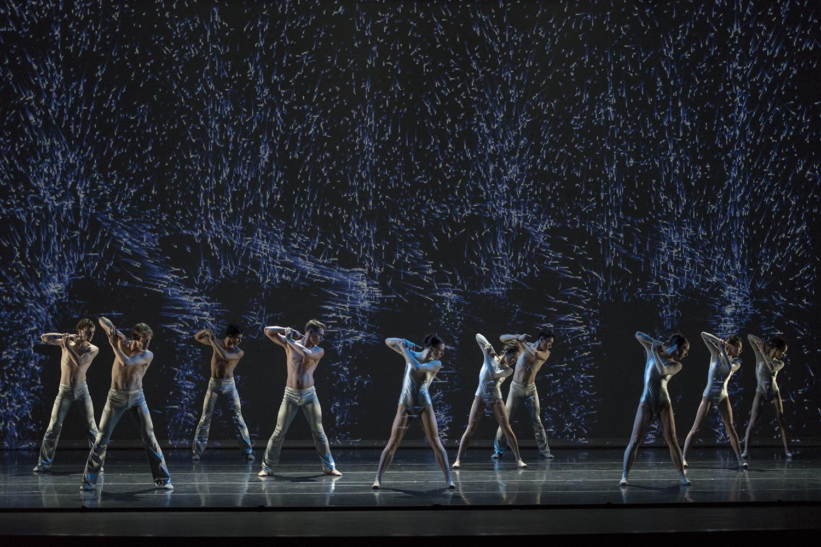
Silicon Valley Ballet
Karen Chik
Jonathan Ho
Bella Sheng
Kathy Tang

Slide 2

SVB History
Non-profit organization
Productions, Ballet School, community work
Factors that may have caused bankruptcy
Notes:
Originally began as joint venture to form San Jose Cleveland Ballet
Bankruptcy?
Began to expand on performances representing the local community - number of which did poorly (large costs, little revenue generation)
New director in late 2012 (controversial)
Loss of significant patrons
Lack of patrons in general

Slide 3
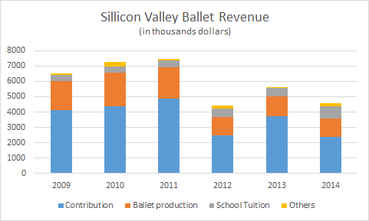
SVB at a glance
Silicon Valley Ballet Revenue
Notes:
Contributions are key to company revenue. Without it, the revenue is extremely small and with declining contributions over each consecutive year, they need to find new ways of obtaining donors.
Donors would consist of parents and members - members would already have donated to company and not possible to forecast their probability of donating; obtaining new donors comes down to highlighting key traits in parents.
Student program has been growing - continues today even though ballet company itself is bankrupt
Compare to SF Ballet?
Larger number of patrons and supports
Endowment to help make up for financial shortcomings

Slide 4
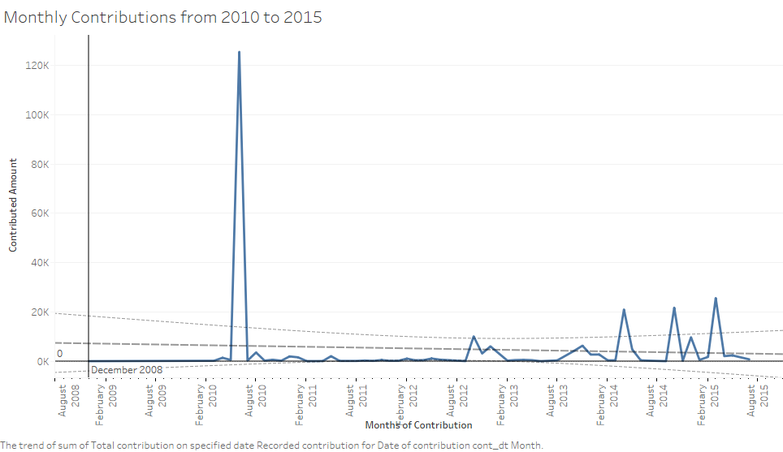
SVB at a glance
Notes:
Make sure to talk about why spike occurs in June 2010
Contributions inconsistent and relatively small across given time period

Slide 5
Which factors forecast whether the audience makes a contribution?

Slide 6
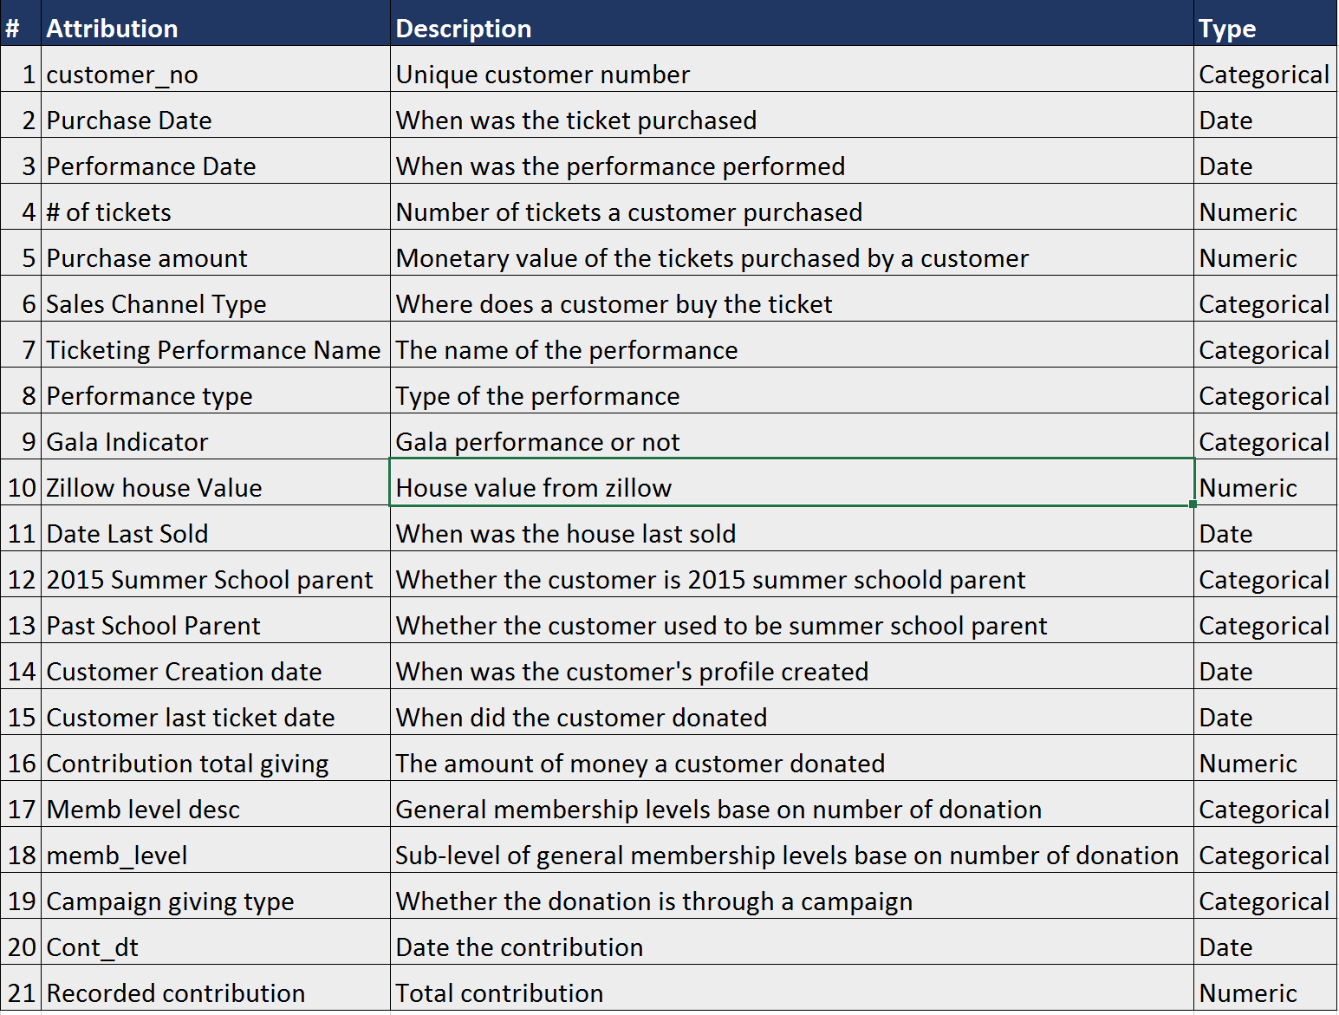
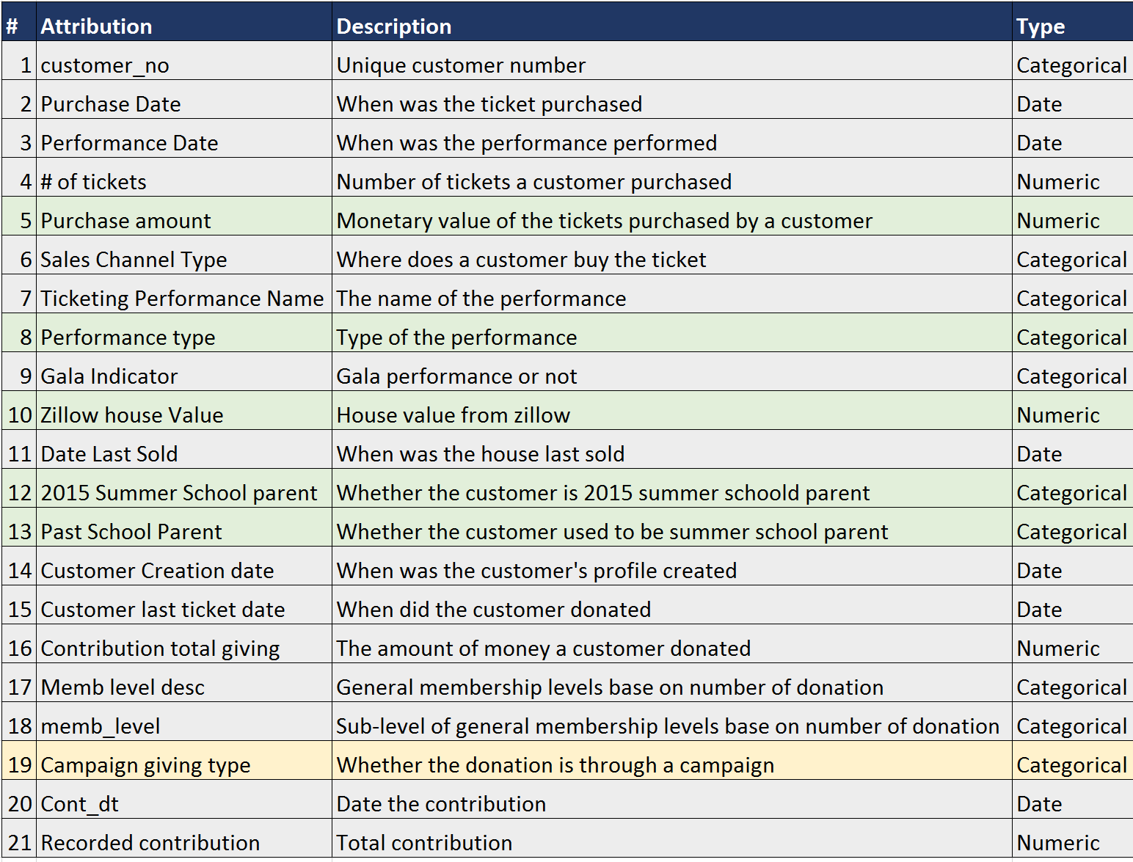
Data Set Information
Summer intern project with 9,000 records
Individual ticket sales and donation records from June 2011 to May 2015
Single tickets (not subscription or group) or more @$40 per ticket
Sales value 0 can be assumed that there was a promotional/comp code applied.
All associations have also been filtered out
Third party ticket sales was removed
Promotional codes have been removed
-Dependent variable: Contributed or not (1/0)
Notes:
The dataset has 9000 records and came from the summer intern project done by Adrian Leetch
It includes the individual ticket sales and donation records
It has more than 20 variables and some limitation of the data
We used to think about doing some analysis on how to increase their ticket sales by analyzing which channel sells the best or what kind of promotions is the most cost-effective, however, as those information are all removed, we cannot do anything further, thus we decide to do some analysis on forecasting whether audience will make contribution or not.
Thus we choose the following explanatory variables:
Purchase amount, how much customer bought
Performance type: whether the performance was nutcracker, story teller or not
Zillow house value, how much the customer’s house value is
2015 summer school parent and past school parent, we combined them and created a dummy to see whether the customer is a parent of school student
Campaign giving type, whether the donation comes from a gala dinner, special event or not. You will notice we highlighted this one in a different color, we will elaborate more on this later

Slide 7
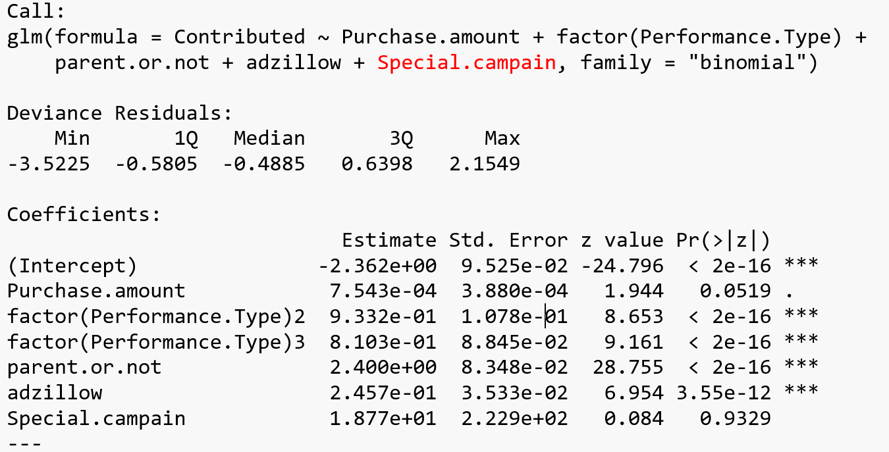
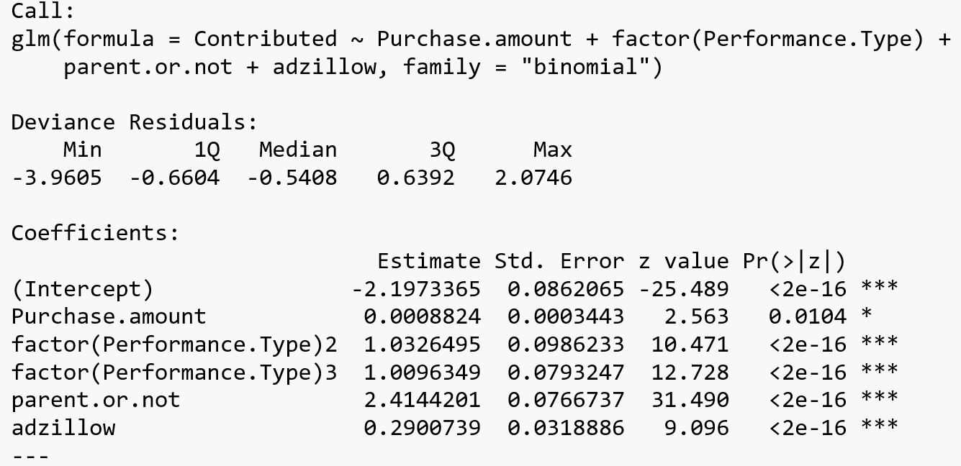
Model Comparison - Binary Logit
Randomly pick 60% as estimation data, 40% as holdout
Likelihood
Accuracy in estimation
Accuracy in holdout
-2250.5 -2675.8
82.25% 77.63%
82.18% 77.91%
Notes:
Then we start to run our models on 60% of the dataset as estimation and the rest as holdout
We run two models, the only difference in those two models is whether include special campaign or not
We found that in the first model that with special campaign, all the variables are significant except for the special campaign.
However, if you look at the number below, you can find that the likelihood of the model with special campaign is lower than the other one, and the forcast accuracy in estimation and holdout is better than the second model

Slide 8
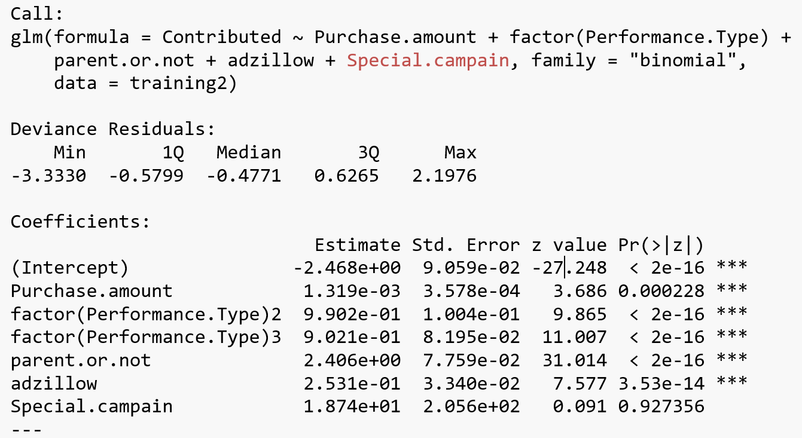
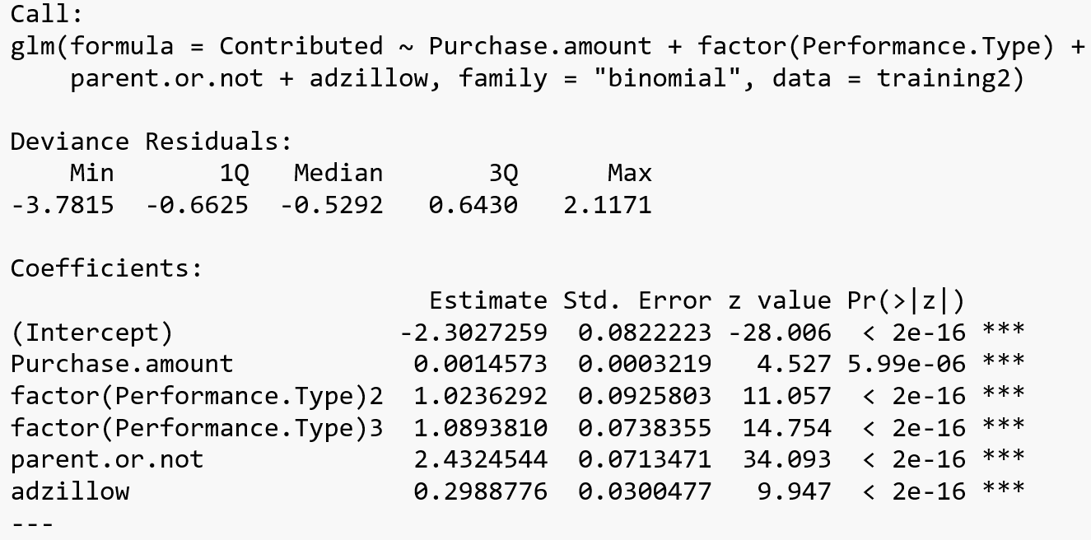
Model Comparison - Binary Logit
Randomly pick 70% as estimation data, 30% as holdout
Likelihood
Accuracy in estimation
Accuracy in holdout
-2609.1 -3092.9
82.22% 77.75%
82.32% 77.58%
Notes:
We use the similar models and run another test on different proportion of the dataset, and the result is similar as the previous one. The special campaign still is not statistically significant, however, the result shows the model with special campaign is better model according to the likelihood and the forecast accuracy is better. Interesting, right? Bella is going to elaborate more on this

Slide 9

Special Campaigns
We believe that Special Campaigns should be included in the model
Special Campaigns: Gala evening
Exclusive patrons: $500 / patron ticket
Awareness of donation: “Funds raised from the evening will …”
Notes:
At the very beginning when we came up with the model, we had the sense that variable “Special Campaigns” must be an important variable to predict the likelihood of a donation happens. And our assumption is: people who attend special campaign are much more likely to donate money to SVB.
We took a look at data, and checked their website, the main special campaigns SVB hold are Gala evenings. A typical patron ticket price is as expensive as $500 / person. People who attend the gala evening should be aware of donating money to the ballet organization. So we assume those people who participant gala evenings are more likely to make contribution. So “Special Campaigns” should be a very meaningful variable to help predict our model.

Slide 10
Statistical Decision VS Business Decision
When the coefficient of “Special Campaign” is not significant, should we drop it?
The answer is: It depends!
How can we test: Using the Holdout sample to test it
The result we get: The model with “Special Campaign” has higher likelihood and accuracy than the model without it
Decision: Keeping “Special Campaign” in our model although “Statistics” says no.
Notes:
However, the statistical result shows that “Special Campaign” is not a valid independent variable to predict the probability of “Contribution” happens. What should we do? Should we give up our assumption and drop the variable?
We use the holdout sample to test two models with/without “Special Campaigns”.
The result is interesting. Although statistically, “Special Campaign” has an insignificant coefficient in the model. The model with it is better than the model without it: higher likelihood and accuracy. We use the holdout model to approve that the “Special Campaign” variable still has prediction power. So we should follow our sense to keep it the model.

Slide 11
MLE method - Drop it or not?
Depends on the purpose:
If you want to predict something, then you want to include variables that have prediction power
If you want to find the drivers of why an event happens, then t stat relevant
Notes:
How can we decide whether to listen to statistical results or not? Is the maximum likelihood always the better option?
The answer is, again, it depends.
It depends on the purpose of the model. If the purpose of the model is to do forecasting, like our model, we’d like to predict the probability of donatio, then we want to include all variables that have prediction power.
If the purpose is to find the drivers of why an event happens, in our case, would be what is the factors to make donations happen, then t stat is relevant.
Since our purpose is to forecast the donation best, we decide to keep “Special Campaign” in our model.

Slide 12
Interpretations
Performances:
People who watch story performances are 14.4% more likely to donate than those who watch the Nutcracker performance
People who watch non story performances are 15% more likely to donate than those who watch the Nutcracker performance
Parents:
Parents of children in the SVB are 26% more likely to donate than those who are not parents
Parents who watched the Nutcracker are 14% more likely to donate than those who are not parents and did not watch the Nutcracker
Notes:
Script:
To interpret our output less technically, we transformed the coefficients into probability.
There are 2 variables that provided interesting insights that I wanted to share with the class:
As it turns out, people who watch performances other than Nutcracker are around 14-15% more likely to donate.
Also, parents of students in the Silicon Valley Ballet are more likely to donate than those who are not parents.
We wanted to test to see whether parents have a bigger impact than viewers of the Nutcracker performance, so we tested the effect of parents who watched the Nutcracker performance. As it turns out, parents who watched the nutcracker are 14% more likely to donate than those who aren’t parents and who didn’t watch the Nutcracker.
Using these numbers, we have come up with two overall findings:

Slide 13
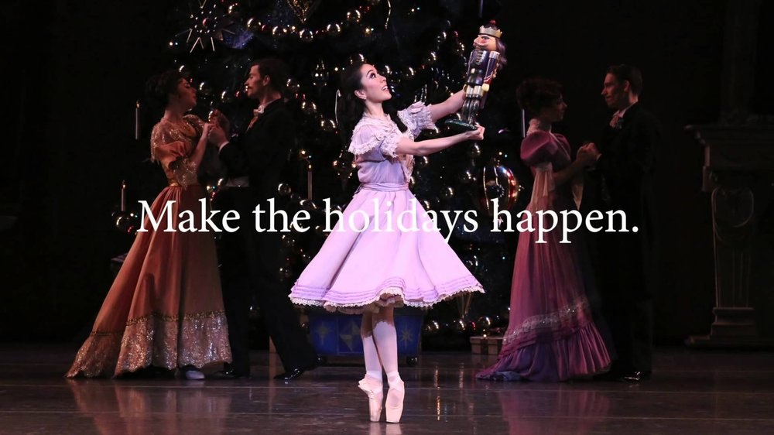
Findings
Nutcracker performance for general entertainment/enjoyment
Notes:
First, the nutcracker performance is mostly enjoyed by the general public as a form of entertainment. It is watched by a lot of people since it is a very popular performance, and attracts not only ballet enthusiasts but others as well.

Slide 14
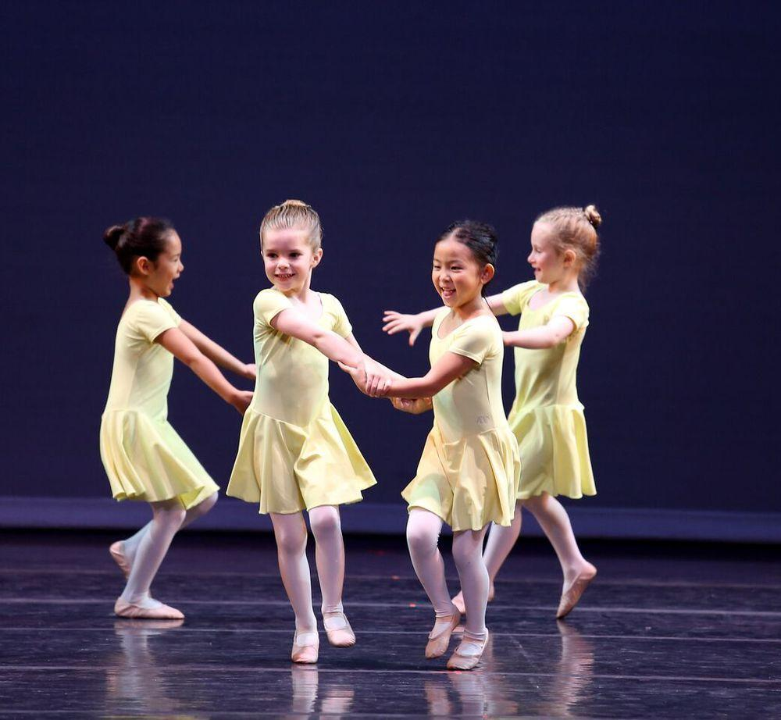
Findings
Parents > Non Parents
Notes:
Parents of students at the Silicon Valley Ballet School are more likely to donate since they are emotionally invested in their children and want them to succeed.

Slide 15
Business Recommendations
Increase student enrollment at SVB school, create more after school/summer school programs. Partner with other schools (ie. Charter schools) to bring in more students
Increase donations from parents of students
Reduce nutcracker performance ticket prices for children and parents
Nutcracker performance perhaps purchased from the general public more who are unlikely to donate. Try to draw in children/young adults to watch performances, promoting SVB school to convert them into students
Increase spending of performances to ‘wow’ audience to convert adults to members or enroll their children to become students

Slide 16
Q&A

Slide 17
Sources
www.siliconvalleyballet.com

Slide 18
Reflection
What problems did we run into?
Data wrangling
Omitting NAs, merging data sets
Scarce variables and observations (Student type would have been meaningful to analyze)
What could have been done to improve findings?
More observations
Compare to industry datasets to find other relevant variables that should be included
What did we learn as a team?
Don’t drop statistically insignificant variables!
Do compare different models
Don’t be to over excited about all the variables you have
Understand what problem you are trying to solve
Notes:
Would be interesting to look at the different class types and effect of donations from parents

Slide 19
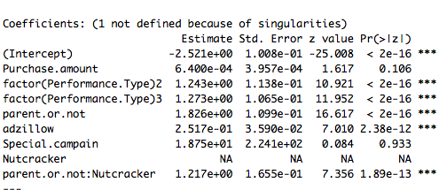
R Output with Interaction Term

Slide 20
Lessons we learned
The purpose of having holdouts
To test on which model is better
You have to have more than one model to do the comparison
How to deal with insignificant variables that should be a factor in the assumption
Running different models with/without it
Testing models using the holdout sample
Making the decision based the comparing result and the purpose of the model

